Slide 1
Azure SQL Database Maximizing Cloud Performance and Availability
Anna Hoffman (Thomas)
Data & Applied Scientist
Microsoft – Azure SQL
antho@microsoft.com
twitter: @AnalyticAnna
Notes:
Thank alain and bob, and akhil

Slide 2
Agenda
Azure SQL overview
Availability
Performance
Questions – now and later

Slide 3
Azure SQL
Choose the right Azure database for your needs
SQL Server on Azure virtual machines
Azure SQL Database managed instance
Azure SQL Database
Best for migrations and applications requiring OS-level access
Best for most lift-and-shift migrations to the cloud
Best for modern cloud applications. Hyperscale and serverless options are available
Infrastructure as a service
Platform as a service
Notes:
SQL virtual machines
Azure manages the host and hardware
You manage the Virtual Machine
Azure provides value-add services
Managed instances
Azure manages the host, hardware, and Virtual Machine
You manage the SQL Server
Azure provides PaaS services
Databases
Azure manages the host, hardware, virtual machine, and SQL Server
You manage the database
Azure provide PaaS services

Slide 4
Availability
Capabilities
Built-in HADR and read replicas
Tasks
Database Availability
Choose Edition for RTO and RPO requirements
Configure HADR
Replication
Monitoring Availability
Database Consistency
Auto and user-controlled BACKUP/RESTORE
Availability Zones
Geo-replication and Failover Groups
Responding to an incident
Notes:
Replication
transaction replication is supported Azure SQL Managed Instance. Merge is not supported.
Azure SQL Database can serve as a push subscriber from a SQL Server on-premises, an Azure VM, or Azure SQL Managed Instance
Note that Log Shipping is not supported to use as a feature even for MI (the underlying technology for LS is used by DMS for online migration to MI)

Slide 5
BACKUP/RESTORE
Auto backups and Point in Time Restore (PITR)
Full Database backup once a week
Log Backups every 5-10 minutes
Differential Backups every 12 hours
Backup files on Azure storage with RA-GRS replicated to paired region
Backup Integrity checks
Restore to new database
Long-term retention (up to 10 years) of backups
Geo-restore of databases if primary region down
Restore backups of deleted databases
Manual COPY_ONLY Backup/Restore with Managed Instance
Backups retained for 7/35 days
Time
Now
-7 days
Self-service restore to a point in time
DB1
DB1
Availability
Notes:
Details for Backup Integrity Checks
On an ongoing basis, the Azure SQL Database engineering team automatically tests the restore of automated database backups of databases placed in logical servers and elastic database pools. (This testing isn't available in managed instance.) Upon point-in-time restore, databases also receive DBCC CHECKDB integrity checks.
Managed instance takes automatic initial backup with CHECKSUM of databases restored with the native RESTORE command or with Azure Data Migration Service after the migration is completed.
Restore to new database
You can deploy a new database also based on a backup
Notes on LTR backups
If you enable LTR policy, the weekly full backups are automatically copied to a different RA-GRS storage container. To meet various compliance requirements, you can select different retention periods for weekly, monthly, and/or yearly backups
LTR not supported on Hyperscale today
Current limits for LTR of backups for Managed Instance
Using long-term backup retention with an Azure SQL Database managed instances has the following limitations:
Limited public preview - This preview is only available to EA and CSP subscriptions and is subject to limited availability.
PowerShell only - There is currently no Azure portal support. LTR must be enabled using PowerShell.
Restore deleted databases
You cannot restore a deletion of a logical server or managed instance. The portal only allows you to restore a deleted database back to the deletion time. You need Powershell or REST to restore a backup of a deleted database from an earlier point of time based on backup retention.

Slide 6

*Not in managed instance
Purchasing models
*
vCore model
Independent scalability
DTU model
Simple, preconfigured
Compute
Compute
Microsoft’s recommendation
Storage
Storage
Pre-packaged, bundled unit that represents the database power
Designed for predictable performance, but somewhat inflexible and limited in options
DTU sizing offers simplicity of choice
This model allows you to independently choose compute and storage resources. It also allows you to use Azure Hybrid Benefit for SQL Server to gain cost savings.
Best for customers who value flexibility, control and transparency
Azure Hybrid Benefit (AHB)
Reserved capacity
Notes:
Vcore choices (up to 80 vCore is the same)
Azure SQL Database
Pick Purchasing Model
If DTU, choose Basic, Standard, or Premium
If vCore then pick Service Tier
If Service Tier is GP, then pick Compute Tier (Provisioned or Serverless) and Compute Hardware
If Hyperscale, pick Compute Hardware and number of Replicas
If BC, pick Compute Hardware, Read Scale out Enabled?, and Zone Redundant?
Azure MI
Choose Service Tier and Compute Hardware
Overview: Azure SQL Database enables you to easily purchase fully managed PaaS database engine that fits your performance and cost needs. Depending on the deployment model of Azure SQL Database, you can select the purchasing model that fits your needs:
Talking Points:
Azure SQL Database give you flexible purchasing models to have simple preconfigured compute & storage or independent control over compute & storage.
vCore model. This model allows you to independently choose compute and storage resources. It also allows you to use Azure Hybrid Benefit for SQL Server to gain cost savings.
Best for customers who value flexibility; control and transparency
Customers can select compute and storage independently
Allows customers to right-size their compute requirements in the cloud
vCore sizing offers flexibility of choice
Database Transaction Unit (DTU) model. Bundled measure of compute, storage and IO resources.
Best for customers who want simple, pre-configured resource options
Reference
https://docs.microsoft.com/en-us/azure/sql-database/sql-database-service-tiers

Slide 7
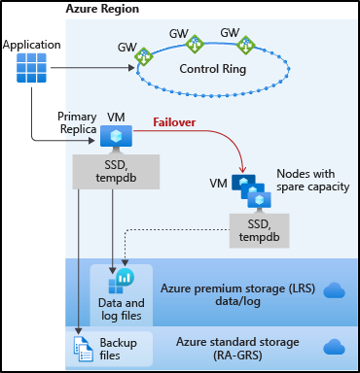
General Purpose
High Availability
Behaves like Failover Cluster Instance
Remote storage provides redundancy within a datacenter
Recovery time depends on spare capacity
Failover decisions based on SQL and Service Fabric
Connectivity redirection built-in
Availability
Notes:
Images from docs https://docs.microsoft.com/en-us/azure/sql-database/sql-database-high-availability
Notes:
Behaves like a Failover Cluster Instance
Azure Storage handles redundancy of files (LRS)
SQL coordinates with Service Fabric for failovers
Backups on different storage with GRS
SSD Cache is Azure Blob Cache
Tempdb kept on local storage
Applies to Azure SQL Database and MI
Force failover using Powershell (see more at https://docs.microsoft.com/en-us/powershell/module/az.sql/invoke-azsqldatabasefailover?view=azps-3.8.0) or REST. There are limits on how often you can do this.
Failover Logic
Spin up a new SQL Server instance on a node with availability
Attach SQL Database files
Run Recovery
Gateways updated for new node. No virtual network or listener required

Slide 8
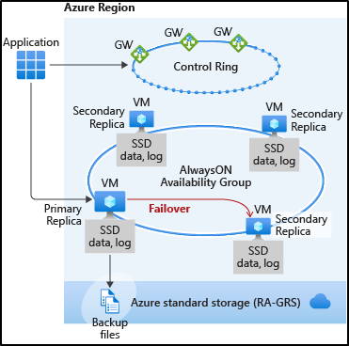
Business Critical
High Availability
3 secondary replicas automatically created
Based on Always On Availability Groups
At least one secondary must sync for commits
Automatic failover based on SQL and Service Fabric
Recovery time extremely fast
Connectivity redirection built-in
Read Scale-Out from one of the replicas
Availability
Notes:
Image comes from https://docs.microsoft.com/en-us/azure/sql-database/sql-database-high-availability#premium-and-business-critical-service-tier-availability
Read more about read scale out at https://docs.microsoft.com/en-us/azure/sql-database/sql-database-read-scale-out
Force failover using Powershell (see more at https://docs.microsoft.com/en-us/powershell/module/az.sql/invoke-azsqldatabasefailover?view=azps-3.8.0) or REST. There are limits on how often you can do this.
Important note about read replicas
Read Scale-Out supports session-level consistency. It means, if the read-only session reconnects after a connection error caused by replica unavailability, it may be redirected to a replica that is not 100% up-to-date with the read-write replica. Likewise, if an application writes data using a read-write session and immediately reads it using a read-only session, it is possible that the latest updates are not immediately visible on the replica. The latency is caused by an asynchronous transaction log redo operation.

Slide 9
Demo Faster failovers with Business critical
Notes:
https://github.com/microsoft/sqlworkshops-azuresqlworkshop/blob/master/azuresqlworkshop/05-Availability/basic-ha/basic-ha.ipynb
Need to have a BC and GP database deployed in order to do side by side

Slide 10
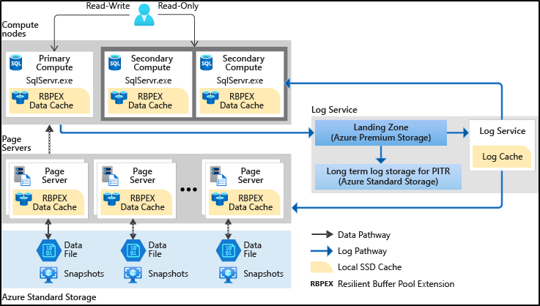
Hyperscale
High Availability
Redundant log and data through Azure Storage
Log Service feeds replicas
Automatic failover based on SQL and Service Fabric
Recovery time depends on existence of replicas
Paired page servers
Read scale on multiple replicas
Backup/Restore snapshots
Availability
Notes:
Image from https://docs.microsoft.com/en-us/azure/sql-database/sql-database-service-tier-hyperscale#distributed-functions-architecture
Log Service feeds replicas
This technology does not use Always On Availability Groups but does use log records to feed changes to secondary replicas
Recovery time depends on existence of replicas
You are not required to have replicas for Hyperscale. If a replica does not exist, HA is still possible but it behaves more like General Purpose since a new primary replica must be deployed.
Backup/Restore snapshots
Hyperscale data files are on Azure Storage and since we have levels of “caching” we can use snapshots to quickly backup and restore a database even if the size is large.

Slide 11

Service tiers
*Not in managed instance
General purpose
Most business workloads
Business Critical
Workloads that require low latency, fast recovery, and a readable secondary
Hyperscale
Most business workloads with highly scalable storage and read-scale requirements
*
remote storage
local storage
local +remote storage
IOPS
IOPS++
IOPS+
P
P
S
S
R
P
R
R
R
R
*
in-memory
unlimited storage
serverless
Availability

Slide 12
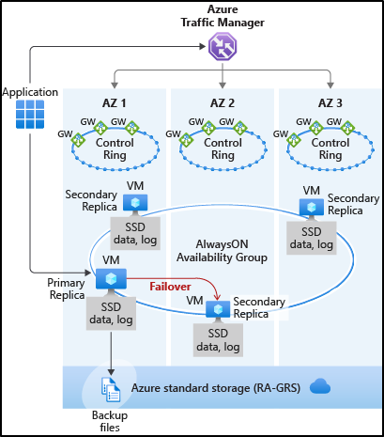
Zone redundant configuration
AZ = Availability Zone
Free for Business Critical/Premium
Replicas are automatically created across zones
Could slow down latency sensitive OLTP applications
Availability
Notes:
Free but also ONLY (today) for BC and Premium. Not available in Managed Instance today. Private Preview today for GP.
Azure Traffic Manager automatically handles routing to correct Gateway. No application logic required.
Some regions are made up of multiple data centers (think campuses)
Availability Zone is one or more physical data centers separated from others but close enough for connectivity
Protect your data from “region” issues by using Zones
Only available today for Premium and Business Critical
Not supported for Managed Instance today
Could slow down latency sensitive OLTP applications
Available in almost all regions

Slide 13
SLAs
service tier | Single zone SLA | Multiple zones SLA
Basic, Standard, General Purpose | 99.99% | TBD
Premium, Business critical | 99.99% | 99.995%
Hyperscale w/ 0 replicas | 99.5% | TBD
Hyperscale w/ 1 replica | 99.9% | TBD
Hyperscale w/ 2+ replica | 99.99% | TBD
Business continuity | Service tier | SLA
Recovery point objective (RPO) | All | 5 sec
Recovery Time Objective (RTO) | Single database | 30 sec
SLA for Azure SQL Database
Availability
Notes:
Only business continuity SLA in the industry, RTO & RPO, 100% service credit
RPO stands for recovery POINT objective, i.e., how much data is one potentially prepared and willing to lose, worst case
RTO stands for recovery TIME objective, i.e., if/when the ‘bad thing’ happens, how much time does it take to be back up and running again

Slide 14
Globally distributed data
 | Geo-replication | Auto-failover groups
Automatic failover | No | Yes
Fail over multiple databases simultaneously | No | Yes
Update connection string after failover | Yes | No
Managed instance supported | No | Yes
Can be in same region as primary | Yes | No
Multiple replicas | Yes | No
Supports read-scale | Yes | Yes
Availability
Notes:
Objective: Active Geo-Replication is available for Basic, Standard, Premium and Premium RS databases. It’s designed for write-intensive applications with the most aggressive recovery requirements. Using Active Geo-Replication, you can create up to four readable secondaries on servers in different regions. You can initiate failover to any of the secondaries. In addition, Active Geo-Replication can be used to support the application upgrade or relocation scenarios, as well as load balancing for read-only workloads. Refer to Design for business continuity for details on how to configure Geo-Replication and to Recover from an outage for details of how to failover to the secondary database. Refer to Application upgrade without downtime for details on how to implement the application upgrade without downtime.
Talking Points:
The Active Geo-Replication feature implements a mechanism to provide database redundancy within the same Microsoft Azure region or in different regions (geo-redundancy). Active Geo-Replication asynchronously replicates committed transactions from a database to up to four copies of the database on different servers. The original database becomes the primary database of the continuous copy. Each continuous copy is referred to as an online secondary database. The primary database asynchronously replicates committed transactions to each of the online secondary databases. While at any given point, the online secondary data might be slightly behind the primary database, the online secondary data is guaranteed to always be transactionally consistent with changes committed to the primary database. Active Geo-Replication supports up to four online secondaries, or up to three online secondaries and one offline secondary.
One of the primary benefits of Active Geo-Replication is that it provides a database-level disaster recovery solution. Using Active Geo-Replication, you can configure a user database in the Premium service tier to replicate transactions to databases on different Microsoft Azure SQL Database servers within the same or different regions. Cross-region redundancy enables applications to recover from a permanent loss of a datacenter caused by natural disasters, catastrophic human errors, or malicious acts.
Another key benefit is that the online secondary databases are readable. Therefore, an online secondary can act as a load balancer for read workloads such as reporting. While you can create an online secondary in a different region for disaster recovery, you could also have an online secondary in the same region on a different server. Both online secondary databases can be used to balance read only workloads serving clients distributed across several regions.
Other scenarios where Active Geo-Replication can be used include:
Database migration: You can use Active Geo-Replication to migrate a database from one server to another online with minimum downtime.
Application upgrades: You can use the online secondary as a fail back option.
To achieve real business continuity, adding redundancy between datacenters to relational storage is only part of the solution. Recovering an application (service) end-to-end after a disastrous failure requires recovery of all components that constitute the service and any dependent services. Examples of these components include the client software (for example, a browser with a custom JavaScript), web front ends, storage, and DNS. It is critical that all components are resilient to the same failures and become available within the recovery time objective (RTO) of your application. Therefore, you need to identify all dependent services and understand the guarantees and capabilities they provide. Then, you must take adequate steps to ensure that your service functions during the failover of the services on which it depends. For more information about designing solutions for disaster recovery, see Designing Cloud Solutions for Disaster Recovery Using Active Geo-Replication.

Slide 15
Demo Geo-distributed applications with auto-failover groups
Notes:
https://github.com/microsoft/sqlworkshops-azuresqlworkshop/blob/master/azuresqlworkshop/05-Availability/fg/fg-powershell.ipynb

Slide 16


Making the right choices
Decide if you need long-term backups
Decide on your RTO and RPO needs
Review the Azure SQL SLA
Do you need read replicas?
Do you need Availability Zones?
Do you need geo HADR or Failover Groups?
Availability
Notes:
To summarize…
Decide if you need long-term backups
Decide on your RTO and RPO needs
Review the Azure SQL SLA
Do you need read replicas?
Do you need Availability Zones?
Do you need geo HADR or Failover Groups?

Slide 17
Performance
Capabilities
Memory, CPU, I/O capacities
Indexes
In-Memory OLTP
Partitions
Tasks
Configuring and Maintaining for Performance
Monitoring and Troubleshooting Performance
Accelerating and Tuning Performance
Intelligent Performance
Performance Scenarios
Performance
Notes:
Gen5: 20.4 GB - 408 GB (5.1GB/vCore) for read-write queries + additional 20.4 GB - 408 GB (5.1GB/vCore) for read-only queries. Add more vCores to get more memory.
Max Capacities
Azure SQL Database - Up to 128 vCores and 4TB Memory and 4TB Database (data)
Hyperscale – 100TB Max Database Size
Managed Instance – Up to 80 vCores, 400GB Memory, and 8TB Database (data)
Use sys.dm_os_job_object for match true capacities.
Indexes
All index types are supported across Azure SQL
Online and resumable indexes fully supported
Columnstore Indexes available in almost all tiers. (not in S0,S1,S2)
In-Memory OLTP
Available in Business Critical Tiers
Memory Optimized FILEGROUP created with database creation
Max memory a ration of overall memory limit
Partitions
Supported for both Azure SQL Database and Managed Instance
Placement on filegroups only supported for Managed Instance
New SQL Server 2019 Performance enhancements
Many of the performance enhancements in SQL Server 2019 are available in Azure SQL. Check the documentation for each option. https://docs.microsoft.com/en-us/sql/sql-server/what-s-new-in-sql-server-ver15?view=sql-server-ver15
Not 100% in Azure SQL (today)
Intelligent Query Processing (except for Scalar UDF Inling)
Automatic Plan Correction

Slide 18
Azure SQL Performance Capabilities
Max Capacities
Azure SQL Database - Up to 128 vCores and 4TB Memory and 4TB Database (data)
Hyperscale – 100TB Max Database Size
Managed Instance – Up to 80 vCores, 400GB Memory, and 8TB Database (data)
sys.dm_os_job_object for true capacities
Indexes
All index types are supported
Online and resumable indexes fully supported
Columnstore Indexes available in almost all tiers
Partitions
Supported for both SQL Database and Managed Instance
Placement on filegroups only supported for Managed Instance
SQL Server 2017/2019 Performance enhancements
Intelligent Query Processing (except for Scalar UDF Inling)
Not 100% in Azure SQL (today)
Automatic Plan Correction
In-Memory OLTP
Available in Business Critical Tiers
Memory Optimized FILEGROUP created with database creation
Max memory a portion of overall memory limit
Performance
Notes:
Gen5: 20.4 GB - 408 GB (5.1GB/vCore) for read-write queries + additional 20.4 GB - 408 GB (5.1GB/vCore) for read-only queries. Add more vCores to get more memory.
Max Capacities
Azure SQL Database - Up to 128 vCores and 4TB Memory and 4TB Database (data)
Hyperscale – 100TB Max Database Size
Managed Instance – Up to 80 vCores, 400GB Memory, and 8TB Database (data)
Use sys.dm_os_job_object for match true capacities.
Indexes
All index types are supported across Azure SQL
Online and resumable indexes fully supported
Columnstore Indexes available in almost all tiers.
In-Memory OLTP
Available in Business Critical Tiers
Memory Optimized FILEGROUP created with database creation
Max memory a ration of overall memory limit
Partitions
Supported for both Azure SQL Database and Managed Instance
Placement on filegroups only supported for Managed Instance
New SQL Server 2019 Performance enhancements
Not 100% in Azure SQL (today)
Intelligent Query Processing (except for Scalar UDF Inling)
Automatic Plan Correction
Many of the performance enhancements in SQL Server 2019 are available in Azure SQL. Check the documentation for each option. https://docs.microsoft.com/en-us/sql/sql-server/what-s-new-in-sql-server-ver15?view=sql-server-ver15

Slide 19
Monitoring and Troubleshooting Performance
Azure Monitor Metrics, Alerts, and Logs
Dynamic Management Views
Extended Events
Lightweight Query Profiling on by default
Query Plan Debugging with SET statements
Query Store on by default
Performance Visualizations in portal
SQL
?
Query Store
Queries
SQL Database
SQL Managed Instance
Deeper insight
Performance
Notes:
Azure Monitor Metrics and Logs
Metrics and events specific to Azure SQL and specific to Azure resources. Tools can be used all over
Dynamic Management Views
Some DMVs unique to Azure
Number of DMVs available different for SQL Server, Azure SQL DB, and MI
For Azure SQL Database many of these need to run in the context of the user database.
Extended Events
Targets: Azure SQL DB supports file, ring_buffer, and counter targets. File targets stored in Azure Blob Storage
Targets Azure MI supports all targets of SQL Server
Events: Azure SQL DB supports a subset of SQL Server events plus Azure specific events
Events: Azure SQL MI supports all SQL Server events plus other Azure specific events
Query Store
Performance Overview and Query Performance Insights in portal uses Query Store
Catalog views and SSMS Reports work just like SQL Server
As of 2/23/2020 Azure SQL MI supports 2400+ events. SQL Server 2019 has 1800+ events
Azure SQL DB supports 392 events
Azure SQL DB has 202 DMVs
Azure SQL MI has 323 DMVs
SQL Server 2019 has 273 DMVs

Slide 20
It is just SQL: Running or Waiting
sys.dm_db_resource_stats
sys.server_resource_stats
Portal/Powershell/Alerts
sys.dm_os_wait_stats , sys.dm_exec_requests
sys.dm_os_waiting_tasks
Query Store
Check Resource consumption
Running (CPU)?
Waiting
IO Latch
Lock Waits
Latch Waits
… Others
Execution
Compilation
Memory Grants
Plan cache eviction
Buffer pool limits
Query Store,
dm_exec_requests,
SOS_SCHEDULER_YIELD waits,
dm_exec_query_stats,
dm_exec_procedure_stats
Performance
Notes:
Alright, so let’s say I get woken up at 2AM for some sort of performance issue in Azure SQL Database. Investigating and checking it out is very similar to on-prem. First, we’ll check the resource consumption right, and if there are issues here I want to start there. So I can check sys.dm_db_resource_stats using the Azure Portal, PowerShell or alerts that we might have set up.
Next, we might check if we are running CPU hot. And if I am, for example let’s say I’m running like 90% over time, I might check, is it execution or compilation overhead? Now we can start to use all our on-prem skills. We can leverage things like the Query Store, dm_exec_query_stats, dm_exec_procedure_stats…
Now, if we aren’t running hot on CPUs and it was pretty clear it wasn’t compilation or execution, then you can look at wait statistics. We’ll try to find what’s waiting, and we do this the same way that you’d do it on-prem. Leveraging the query store, there are actually certain waits that get stored there too.
So the only big difference is checking that resource consumption.
GP 2vCore says memory limit is ~10Gb. Dm_os_performance_counters shows Target at 7Gb after db is created. I could never get the Target to go above that number. What is the other 3Gb used for?
Use Running vs Waiting as you would SQL Server
Resolve blocking and deadlocking just as you would SQL Server
High CPU typically requires query tuning or more CPUs resources
PAGEIOLATCH and WRITELOG high wait times may require
Change Pricing Tier to get better IOPs and/or latency.
For Managed Instance, # files and/or file size can help with IOPs and I/O throttling
Business Critical is always the best for I/O sensitive applications
You may not have enough memory so move up tier or cores to get more
Applications may not be tuned such as singleton transactions or scans
PAGELATCH waits are just like SQL Server.
Databases use indirect checkpoints
Buffer Pool Limits
Target is set to around “limit” in the docs – 3Gb. (3Gb is reserved for other memory requirements of the database and instance)
You cannot control max or min server memory
Managed Instance supports RG
Memory Grants
Over and underestimate can still be an issue
There is no RG control for this except in MI
Plan Cache Eviction
Do gateways still exist?
FORCED_PARAMETERIZATION supported for DB and MI
Optimized for ad hoc workloads supported in MI but not in DB

Slide 21
Accelerating and Tuning Performance
Scaling CPU Capacity
I/O performance
Increasing Memory or Workers
Improving Application Latency
Use redirect connections and not proxy
Optimize “chatty” applications
For DB, scale up vCores with higher limits for more memory or workers
For MI, scale up vCores for more memory
Max worker threads for MI
Consider multi-statement transactions for log I/O latency
Do you know IOPS? IOPS restrictions may show up in the form of longer I/O waits
Scale up vCores or move to Business Critical/Hyperscale for higher IOPS
For faster I/O latency for DB, consider Business Critical or Hyperscale
For faster I/O latency for MI, move to Business Critical or change # files or file size
Portal, T-SQL, Powershell, or REST
Downtime (can be very fast) but no migration required
Hyperscale can scale in constant time
Tune your SQL queries just like you would with SQL Server:
Indexes
Batching
Stored Procs
Parameterization
Process Result Sets
Performance
Notes:
Note: For multi-statement transactions there could be a balance in this improving I/O latency for the transaction log and running into log rate governance. In other words, if you group too many transactions you could hit a log rate governance limit depending on your tier.
Scaling CPU Capacity
Portal, T-SQL, Powershell, or REST
Downtime (can be very fast) but no migration required
Hyperscale can scale in constant time
I/O performance
Do you know IOPS? IOPS restrictions may show up in the form of longer I/O waits
Scale up vCores or move to Business Critical/Hyperscale for higher IOPS
For faster I/O latency for DB, consider Business Critical or Hyperscale
For faster I/O latency for MI, move to Business Critical or change # files or file size
Consider multi-statement transactions for log I/O latency
Increasing Memory or Workers
For DB, scale up vCores with higher limits for more memory or workers
For MI, scale up vCores for more memory
Max worker threads for MI
Improving Application Latency
Use redirect connections and not proxy
Optimize “chatty” applications

Slide 22
Demo Monitoring and tuning performance
Notes:
Use activity 1 and 2 from https://github.com/microsoft/sqlworkshops-azuresqlworkshop/blob/master/azuresqlworkshop/04-Performance.md#1

Slide 23
Azure Specific Performance Scenarios
Log Governance
LOG_RATE_GOVERNOR wait for Azure SQL Database
INSTANCE_LOG_GOVERNOR wait for Azure SQL Managed Instance
Worker Limits
Error when concurrent worker limit reached for Azure SQL Database
Managed Instance = SQL Server worker threads and THREADPOOL waits
Business Critical HADR Waits
HADR_DATABASE_FLOW_CONTROL
HADR_THROTTLE_LOG_RATE_SEND_RECV
Hyperscale
RBIO* waits for log rate throttling
HADR_SYNC_COMMIT
POOL_LOG_RATE_GOVERNOR wait for Elastic Pools
HADR_THROTTLE_LOG_RATE* wait for Business Critical and Geo-Replication latencies
Page Server Reads in DMVs, catalog views, and Extended Events
Performance
Notes:
Log Governance – this is a governance of transaction log record generation rates not I/O. See this doc for more info: https://docs.microsoft.com/en-us/azure/sql-database/sql-database-resource-limits-database-server#transaction-log-rate-governance --- HS tier provides 100MB/s log rate regardless of service level
LOG_RATE_GOVERNOR wait
INSTANCE_LOG_GOVERNOR wait
Worker Limits
Error when concurrent worker limit reached for Azure SQL Database
Managed Instance = SQL Server worker threads and THREADPOOL waits.
Be Aware Of….
Business Critical have AG replicas on by default so you may see HADR* waits
Hyperscale
For a complete set of diagnostics on Hyperscale reads the docs at https://docs.microsoft.com/en-us/azure/sql-database/sql-database-hyperscale-performance-diagnostics.

Slide 24
Intelligent Performance
Intelligent Query Performance
Automatic Plan Correction
Automatic Tuning
Performance
Notes:
Intelligent query performance
Built into the Query Processor
Adapt to different workloads to improve performance with no code changes
Enabled through Database Compatibility Level
Adaptive QP = dbcompat 140
Bold = dbcompat 150
Automatic plan correction
Continuous performance plan monitoring and analysis
Based on Query Store
Detect and fix problematic plans based on regressions
Fix ON by default for Azure SQL
Part of Automatic Tuning family
Results only exposed through DMV
Automatic tuning
Index Recommendations
ML approach based on DMVs and Query Store
Parameterized Query Recommendations
View in DMVs and Azure Portal

Slide 25
Demo Automatic tuning
Notes:
https://ms.portal.azure.com/#@microsoft.onmicrosoft.com/resource/subscriptions/741fd0f5-9cb8-442c-91c3-3ef4ca231c2a/resourceGroups/widemo/providers/Microsoft.Sql/servers/widemo/databases/WorkloadInsightsDemo/performanceOverview

Slide 26
Performance Summary
Fixed capacities to choose from for CPU, memory, and I/O
Tools exist like DMVs and Extended Events like SQL Server
Query Store on by default
New Azure functionality exists like Azure Metrics, new DMVs, new wait types
Resource governance specific to Azure
Intelligent Performance to get faster with no code changes
Scale up and down without need to migrate
Notes:
Fixed capacities to choose from for CPU, memory, and I/O.
Tools exist like DMVs and Extended Events like SQL Server.
Query Store on by default and powers query tuning.
New Azure functionality exists to replace existing functionality like Azure Metrics.
DMVs exist that are new and designed for Azure.
New wait types exist specific to Azure.
Resource governance is specific to Azure.
Scale up and down without need to migrate.
Intelligent Performance to get faster with no code changes.

Slide 27
Thank you!
Anna Hoffman
@AnalyticAnna
aka.ms/annalytics – presentations including this deck
aka.ms/dataexposed – Channel9
aka.ms/dataexposedyt – YouTube
aka.ms/sqlworkshops – see the Azure SQL Workshop (preview)

Slide 28
ALTER DATABASE SCOPED CONFIGURATION
sp_configure supported for MI
Query hints allowed
MI supports RG
Configuring for Performance
Tempdb
Database
Files and Filegroups
MAXDOP
Resource Governor
Only full recovery supported so minimal logging for bulk operations not possible
User defined Managed Instance only
Always kept on local SSD drives
For GP, # files scales with vCores
You get 12 files with MI but you can increase
MIXED_PAGE_ALLOCATION IS OFF
AUTOGROW_ALL_FILES is ON
Tempdb Metadata Optimization not supported
MI supports adding files and sizes but not physical placement
# files and file size can be used to tune I/O performance
User defined FILEGROUP not supported
Capabilities – Configuring – Maintaining – Monitoring and troubleshooting – Scenarios – Intelligence
Notes:
Configuring Tempdb
Always kept on local SSD drives so I/O perf shouldn’t be an issue
For GP, we scale # files with vCores (2vcores=4 files,…) max of 16.
You get 12 files with MI independent of vCores but you can increase # files with T-SQL
MIXED_PAGE_ALLOCATION IS OFF and AUTOGROW_ALL_FILES is ON for tempdb
Tempdb Metadata Optimization not supported
Database Configuration
Only full recovery supported so minimal logging for bulk operations not possible
Configuring Files and Filegroups
MI supports adding files and sizes but not physical placement
# files and file size can be used to tune I/O performance. Read more here. https://techcommunity.microsoft.com/t5/datacat/storage-performance-best-practices-and-considerations-for-azure/ba-p/305525
User defined FILEGROUP not supported but you can’t physically place files anyway.
Configuring MAXDOP
ALTER DATABASE SCOPED CONFIGURATION for DB and MI
sp_configure supported for MI
Query hints allowed
MI supports RG
Server Configuration Optimized for ad hoc workloads supported in MI but not in DB
Resource Governor User defined managed instance only

Slide 29


Maintaining for Performance
Maintaining Indexes
REBUILD and REORG
Maintaining Statistics
Automatic Stats
Capabilities – Configuring – Maintaining – Monitoring and troubleshooting – Scenarios – Intelligence
Notes:
Maintaining Indexes
REBUILD and REORG fully supported for DB and MI
Maintaining Statistics
Automatic Stats supported for DB and MI just like SQL Server
Note: Maintenance Plans in SSMS are not available in DB or MI

Slide 30
Dynamic Management Views
Azure SQL Managed Instance
All SQL Server DMVs available
sys.server_resource_stats
Azure SQL Database
Common SQL Server DMVs available
sys.dm_db_resource_stats
sys.dm_elastic_pool_resource_stats
You will need these
Geek Out
sys.dm_io_virtual_file_stats
sys.dm_os_performance_counters
sys.user_db_resource_governance_internal
sys.dm_resource_governor_resource_pools_history_ex
sys.dm_resource_governor_workload_groups_history_ex
sys.dm_user_db_resource_governance
Capabilities – Configuring – Maintaining – Monitoring and troubleshooting – Scenarios – Intelligence
Notes:
Azure Monitor Metrics and Logs
Metrics and events specific to Azure SQL
Metrics and events for Azure resources
Dynamic Management Views
For Azure SQL Database many of these need to run in the context of the user database.
Some DMVs unique to Azure
Number of DMVs available different for SQL Server, Azure SQL DB, and MI
Query Store
Performance Overview and Query Performance Insights in portal uses Query Store
Catalog views and SSMS Reports work just like SQL Server
Extended Events
Azure SQL DB supports file, ring_buffer, and counter targets. File targets stored in Azure Blob Storage
Azure MI supports all targets of SQL Server
Azure SQL DB supports a subset of SQL Server events plus Azure specific events
Azure SQL MI supports all SQL Server events plus other Azure specific events
As of 2/23/2020 Azure SQL MI supports 2400+ events. SQL Server 2019 has 1800+ events
Azure SQL DB supports 392 events
Azure SQL DB has 202 DMVs
Azure SQL MI has 323 DMVs
SQL Server 2019 has 273 DMVs

Slide 31
Extended Events with Azure SQL
Azure SQL Database
Most common events and actions
File (Azure Blob Storage), ring_buffer, and counter targets
Azure Managed Instance
All targets and actions supported
File targets to Azure Blob Storage
Azure MI supports all SQL Server events plus Azure specific events
Capabilities – Configuring – Maintaining – Monitoring and troubleshooting – Scenarios – Intelligence

Slide 32
Intelligent Query Performance
Intelligent QP
Built into the Query Processor
Adapt to different workloads to improve performance with no code changes
Enabled through Database Compatibility Level
Adaptive QP = dbcompat 140
Bold = dbcompat 150
Adaptive QP
Table Variable Deferred Compilation
Batch Mode for Row Store
Approximate QP
Scalar UDF inlining
²
Adaptive Joins
Interleaved Execution
Memory Grant Feedback
Approximate Count Distinct
¹
Batch Mode
Batch Mode
Row Mode
1Approximate Count Distinct does not require dbcompat level
2 Not currently available with Azure SQL Database
Capabilities – Configuring – Maintaining – Monitoring and troubleshooting – Scenarios – Intelligence

Slide 33
Automatic Plan Correction
Continuous performance plan monitoring and analysis
Based on Query Store
Detect and fix problematic plans based on regressions
Fix ON by default for Azure SQL
Part of Automatic Tuning family
Results only exposed through DMV
Query times
Plan 1
Plan 2
Plan 3
Plan 2
Revert to previously effective plan
Capabilities – Configuring – Maintaining – Monitoring and troubleshooting – Scenarios – Intelligence

Slide 34
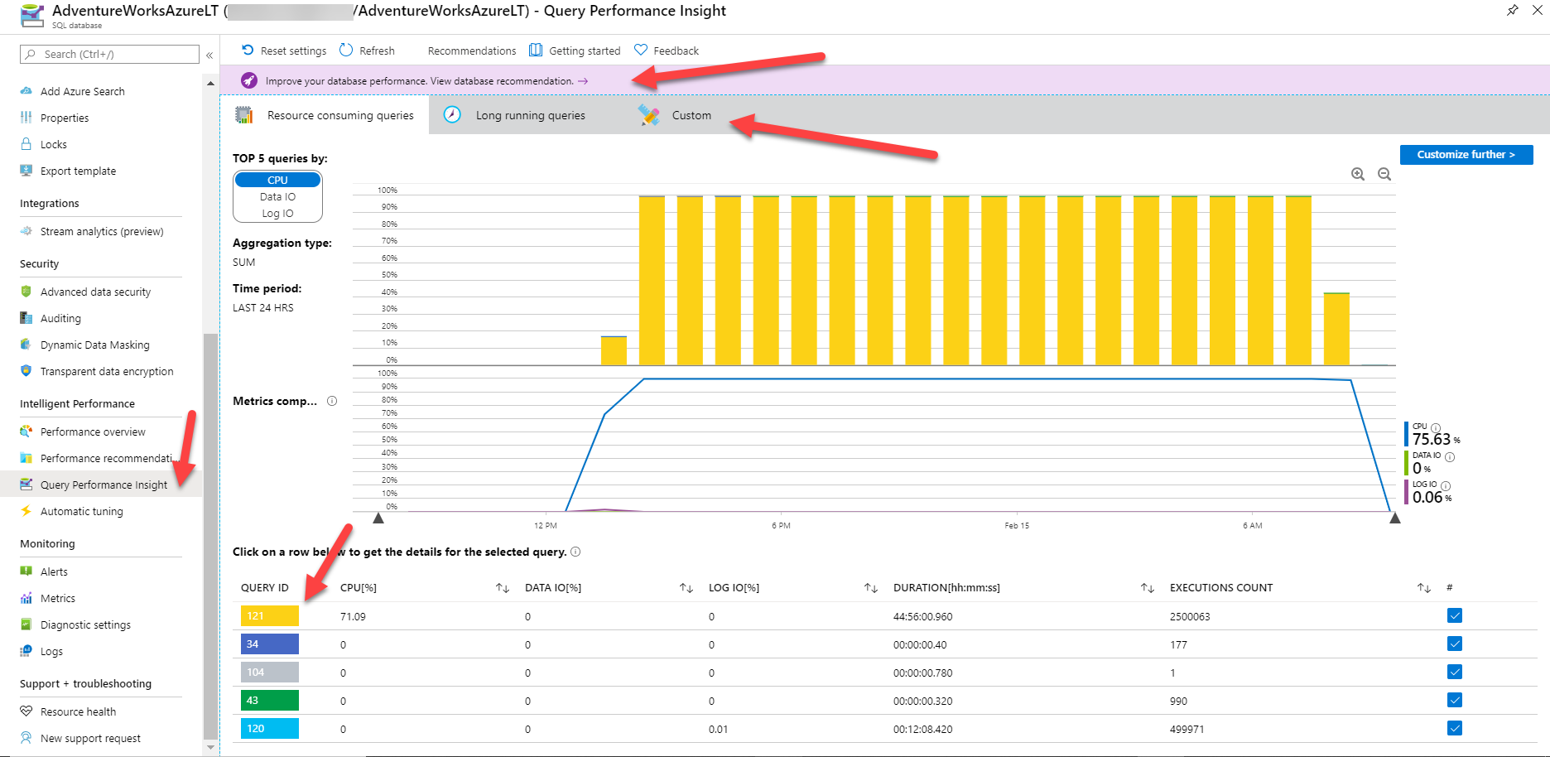
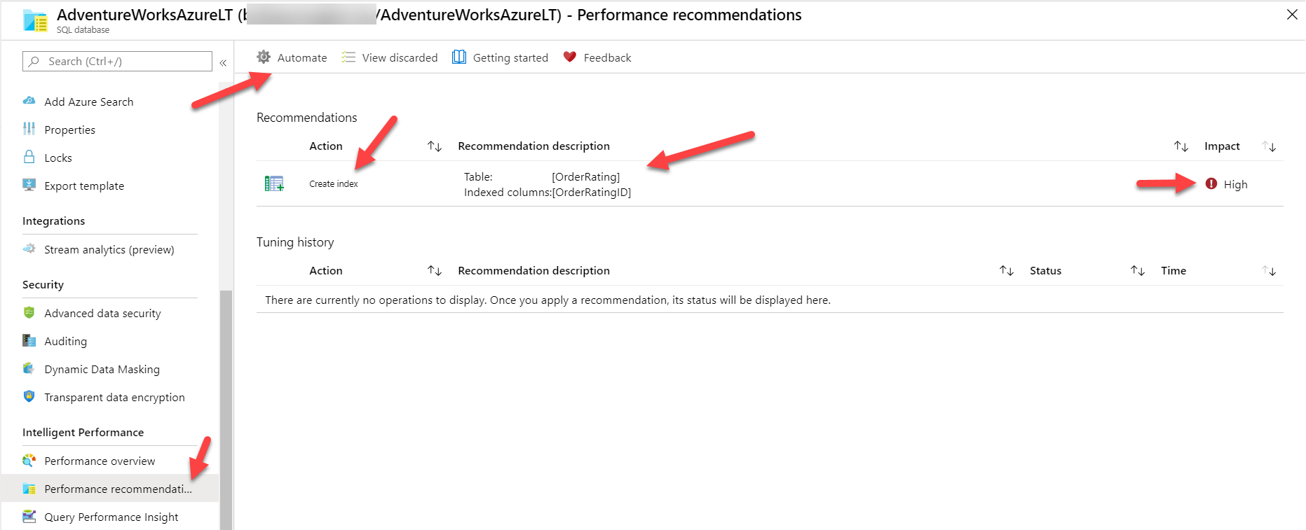
Automatic Tuning with Azure SQL Database
Index Recommendations
ML approach based on DMVs and Query Store
Parameterized Query Recommendations
View in DMVs and Azure Portal
Capabilities – Configuring – Maintaining – Monitoring and troubleshooting – Scenarios – Intelligence

Slide 35
aka.ms/asw05 (Bonus) Activity 1: Restore to a point in time Activity 2: Basic HA in Azure SQL Database Activity 3: Turn-key AGs in Business critical Activity 4: Geo-distributed auto-failover groups with read-scale

Slide 36
aka.ms/asw04 Activity 1: How to monitor performance in Azure SQL Database Activity 2: Scaling your workload performance in Azure SQL Database Activity 3: Optimizing application performance in Azure SQL Database (Bonus) Activity 4: Using Automatic Tuning in Azure SQL Database

Slide 37
05 – Availability

Slide 38
Monitoring Availability
Azure portal
Monitor Resource Health for failover events
Service Health Dashboard and feeds
Azure Monitor
XEvents
Command line
Azure CLI
Az Module for PowerShell
REST APIs
Log Analytics
Custom dashboards
KQL
SSMS
DMVs
Capabilities – Choices – Configure – Monitor – Respond
Notes:
Monitor Resource Health for failover events
XEvents?
Log Analytics?
Service Health Dashboard and feeds
CLI and Powershell?

Slide 39
Common Performance Scenarios
Use Running vs Waiting as you would SQL Server
Resolve blocking and deadlocking just as you would SQL Server
High CPU typically requires query tuning or more CPUs resources
PAGEIOLATCH and WRITELOG high wait times may require
Change Pricing Tier to get better IOPs and/or latency.
For Managed Instance, # files and/or file size can help with IOPs and I/O throttling
Business Critical is always the best for I/O sensitive applications
You may not have enough memory so move up tier or cores to get more
Applications may not be tuned such as singleton transactions or scans
PAGELATCH waits are just like SQL Server.
Databases use indirect checkpoints
Buffer Pool Limits
Target is set to around “limit” in the docs – 3Gb. (3Gb is reserved for other memory requirements of the database and instance)
You cannot control max or min server memory
Managed Instance supports RG
Memory Grants
Over and underestimate can still be an issue
There is no RG control for this except in MI
Plan Cache Eviction
Do gateways still exist?
FORCED_PARAMETERIZATION supported for DB and MI
Optimized for ad hoc workloads supported in MI but not in DB
Notes:
BPool
GP 2vCore says memory limit is ~10Gb. Dm_os_performance_counters shows Target at 7Gb after db is created. I could never get the Target to go above that number. What is the other 3Gb used for?

Slide 40

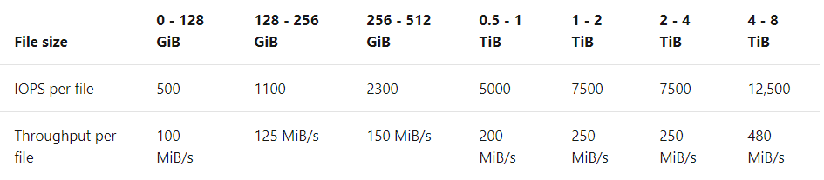
General Purpose Architecture
Cloud Database Architecture
Separation of compute and storage
Stateless compute VM
TempDB on local SSD
Azure Premium Storage
Replicated remote files
Active compute node
Redundant node
Property | Value
vCores | 4-80
Memory | 5.1 GB/core
IO latency | 5-10ms
IOPS | Up to 30K
Load | 22MB/s
Scaled node
Azure storage account
Capabilities – Choices – Configure – Monitor – Respond

Slide 41
Business Critical Architecture
Primary endpoint
(read-write)
All databases on local SSD
Failed node is replaced with the spare
Always On AG
Super-fast SSD
Property | Value
vCores | 4-80 + 4-80 (read-only)
Memory | 5.1 GB/core + 5.1 GB/core (read-only)
IO latency | < 3 ms
In-memory OLTP | Yes 3GB-130GB
Load | 48 MB/s
Secondary replica
Primary replica
Secondary replica
Spare node
Secondary replica
Secondary replica
Secondary endpoint
(read-only)
Capabilities – Choices – Configure – Monitor – Respond

Slide 42
Business Critical – Upgrade SLO
Primary endpoint
(read-write)
Always On AG
Always On AG
Super-fast SSD
Super-fast SSD
Secondary replica
Primary replica
Secondary replica
Primary replica
Secondary replica
Secondary replica
Secondary replica
Secondary replica
Secondary endpoint
(read-only)
Capabilities – Choices – Configure – Monitor – Respond

Slide 43
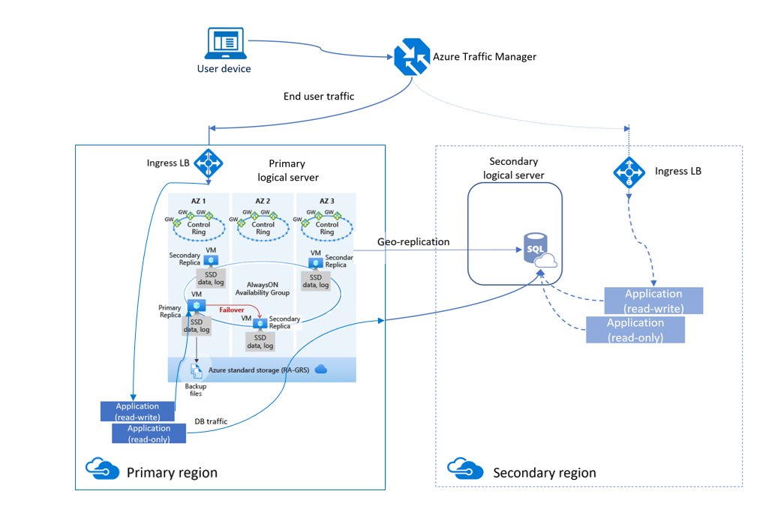
Zone Redundancy and GeoDR
ZR should be enabled for all production databases
GeoDR should be enabled for more critical databases
Tier 1 apps should use a combination of ZR and GeoDR

Slide 44
Database Availability
Fast Recovery On by Default?
Accelerated Database Recovery
Parallel Redo?
Deferred Recovery On?
Are database states the same as SQL Server?
Emergency Mode Repair not allowed
DAC connections allowed?
Capabilities – Choices – Configure – Monitor – Respond

Slide 45


Accelerated Database Recovery (ADR)
Read the paper
How it works
On by default for Azure SQL Database and Managed Instance (and cannot be disabled)
Uses a Persisted Version Store (PVS)
Independent of locking and isolation levels
Rollback faster than you can react
Undo recovery faster than you can look it up
Transaction log truncation not tied to active transactions
Key questions
Does it require more space?
Will it affect performance?
Will I still see versions in tempdb?
How does it work with HA?
Accelerated Database Recovery powers Azure SQL Database Hyperscale
Mission critical high availability
Capabilities – Choices – Configure – Monitor – Respond
Notes:
Format and separate the two sections

Slide 46

Database Consistency in Azure SQL
DBCC CHECKDB
Stale Page Detection
Auto Page Repair for Business Critical
Data integrity error alert monitoring
Backup and restore integrity checks
I/O system “lost write” detection
INCIDENT
24x7 support across all Azure teams
Types of incident:
System Data Integrity
Customer Data Integrity
Capabilities – Choices – Configure – Monitor – Respond
Notes:
CHECKDB
Stale Page Detection
Auto Page Repair for Business Critical
Highlight talking points in this blog https://azure.microsoft.com/en-us/blog/data-integrity-in-azure-sql-database/
Sprinkle in some of my own CSS “stuff”

Slide 47
Configuring HADR
Deploy with Edition and Tier that matches your RTO, RPO, and SLA
Point in Time Restore may not be available immediately after deploy
Configure Long-term backup retention
Configure geo-replication or Failover Group
Is your application ready?
Capabilities – Choices – Configure – Monitor – Respond

Slide 48
Monitoring Availability
Monitor Resource Health for failover events
XEvents?
Log Analytics?
Service Health Dashboard and feeds
CLI and Powershell?

Slide 49
Responding to a problem
Responding to an outage
Auto HA might have kicked in without you knowing about it.
Delete a database? Try to restoring from “recycled bin”
Data Center or Region outage
Manual Failover if not Failover Group
Root Cause Analysis
Capabilities – Choices – Configure – Monitor – Respond

